Slide 1


RESTAURANT CUSTOMER SATISFACTION PREDICTION
Develops a machine learning model to analyze and predict customer satisfaction using key restaurant service features.
Presented By:
Clare Grace P.R

Slide 2
build a predictive model.
INTRODUCTION
In the competitive restaurant industry, customer satisfaction plays a vital role in business growth. Machine Learning helps analyze customer data efficiently and predict satisfaction levels. This project uses customer experience factors to build a predictive model.

Slide 3
IMPORTANCE OF CUSTOMER SATISFACTION
Customer satisfaction directly impacts a restaurant’s success, reputation, and profitability. In a competitive market, understanding what makes customers satisfied helps businesses improve service quality and retain customers.
Manually analyzing customer feedback is time-consuming and may not provide accurate insights. By using machine learning, restaurants can:
•Identify key factors affecting satisfaction (like service quality, food quality, waiting time).
•Predict customer satisfaction levels quickly and accurately.
•Enhance customer experience.

Slide 4
PROBLEM STATEMENT
Restaurants collect large amounts of customer feedback, but analyzing it manually is time-consuming and inefficient.
It is difficult to identify which service factors most strongly influence customer satisfaction.
There is a need for a data-driven approach to predict customer satisfaction accurately.
This project aims to develop a machine learning model to predict customer satisfaction based on key service and dining factors.

Slide 5
OBJECTIVES
The goal of this project is to develop a machine learning model to predict restaurant customer satisfaction based on key service and dining-related factors.
It aims to analyze customer data to identify the most significant factors influencing satisfaction levels.
The project involves performing exploratory data analysis and applying multiple machine learning algorithms for accurate prediction.
The best-performing model is selected based on evaluation metrics

Slide 6
DATASET OVERVIEW
Dataset Name:
Restaurant Customer satisfaction Dataset
Source:
Collected from Kaggle
Target Variable:
Customer Satisfaction

Slide 7
EDA Visuals:
Customer Satisfaction Distribution
Age Distribution of Customers
Gender vs Customer Satisfaction
Ratings Distribution
Key Insights: Customer satisfaction is mainly influenced by service and rating factors, while demographic factors like age and gender show minimal impact.
Visualizations Include:
Bar chart, Histogram, Clustered bar chart, Multiple(subplot) bar chart

Slide 8
Models Used &Results
Models Applied:
• Logistic Regression – Baseline classification model
• K-Nearest Neighbors (KNN) – Distance-based classification model • Decision Tree Classifier – Captures decision rules • Random Forest Classifier – Handles complex feature interactions
Best Model: Random Forest
• Accuracy: 0.87
• Precision: High classification performance • Recall: Strong detection of satisfied customers • F1-Score: Balanced performance

Slide 9
Observations and Insights:
Higher Waiting Time is associated with lower satisfaction levels.
Staff Behavior significantly influences overall customer experience.
Demographic fact Service Quality and Food Quality have the strongest positive impact on customer satisfaction.
Demographic factors such as Age and Gender show minimal impact compared to service-related factors.

Slide 10
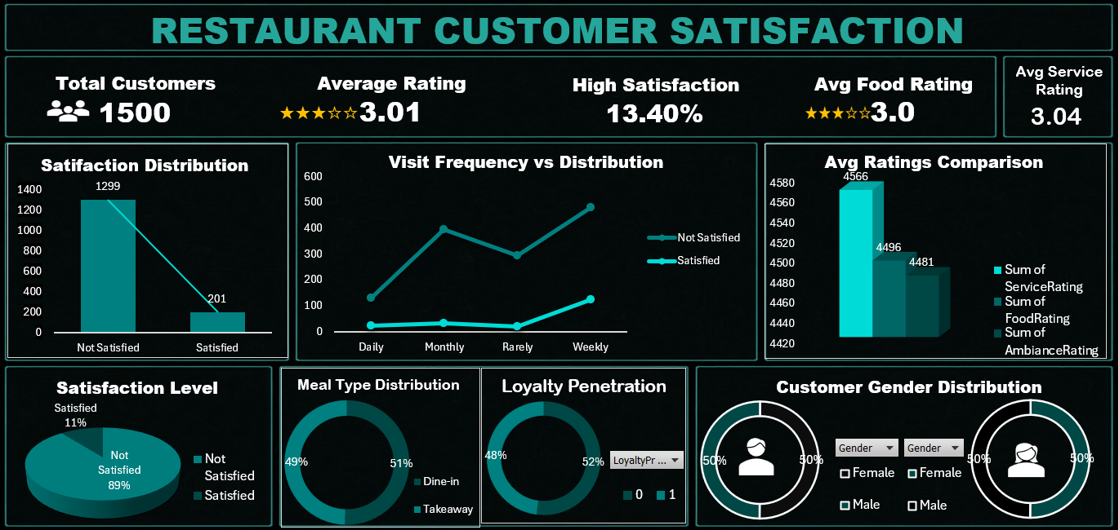
DASHBOARD

Slide 11
Conclusion
This project successfully demonstrates the application of machine learning techniques to predict restaurant customer satisfaction based on service and rating related factors. Through exploratory data analysis and model comparison, key factors such as Service Quality, Food Quality, Ambiance, Age Distribution ,Based on gender were identified as major contributors to customer satisfaction.
Among the models implemented, the Random Forest Classifier achieved the highest performance and was selected as the final model.

Slide 12
THANK YOU

